Slide 1
Antisocial
Final Presentation

Slide 2




Our goals (remind)
Main Goals:
Develop Android app to block social apps;
Extended Goals:
Develop Web backend to store the user data;
Develop Windows Phone app;

Slide 3

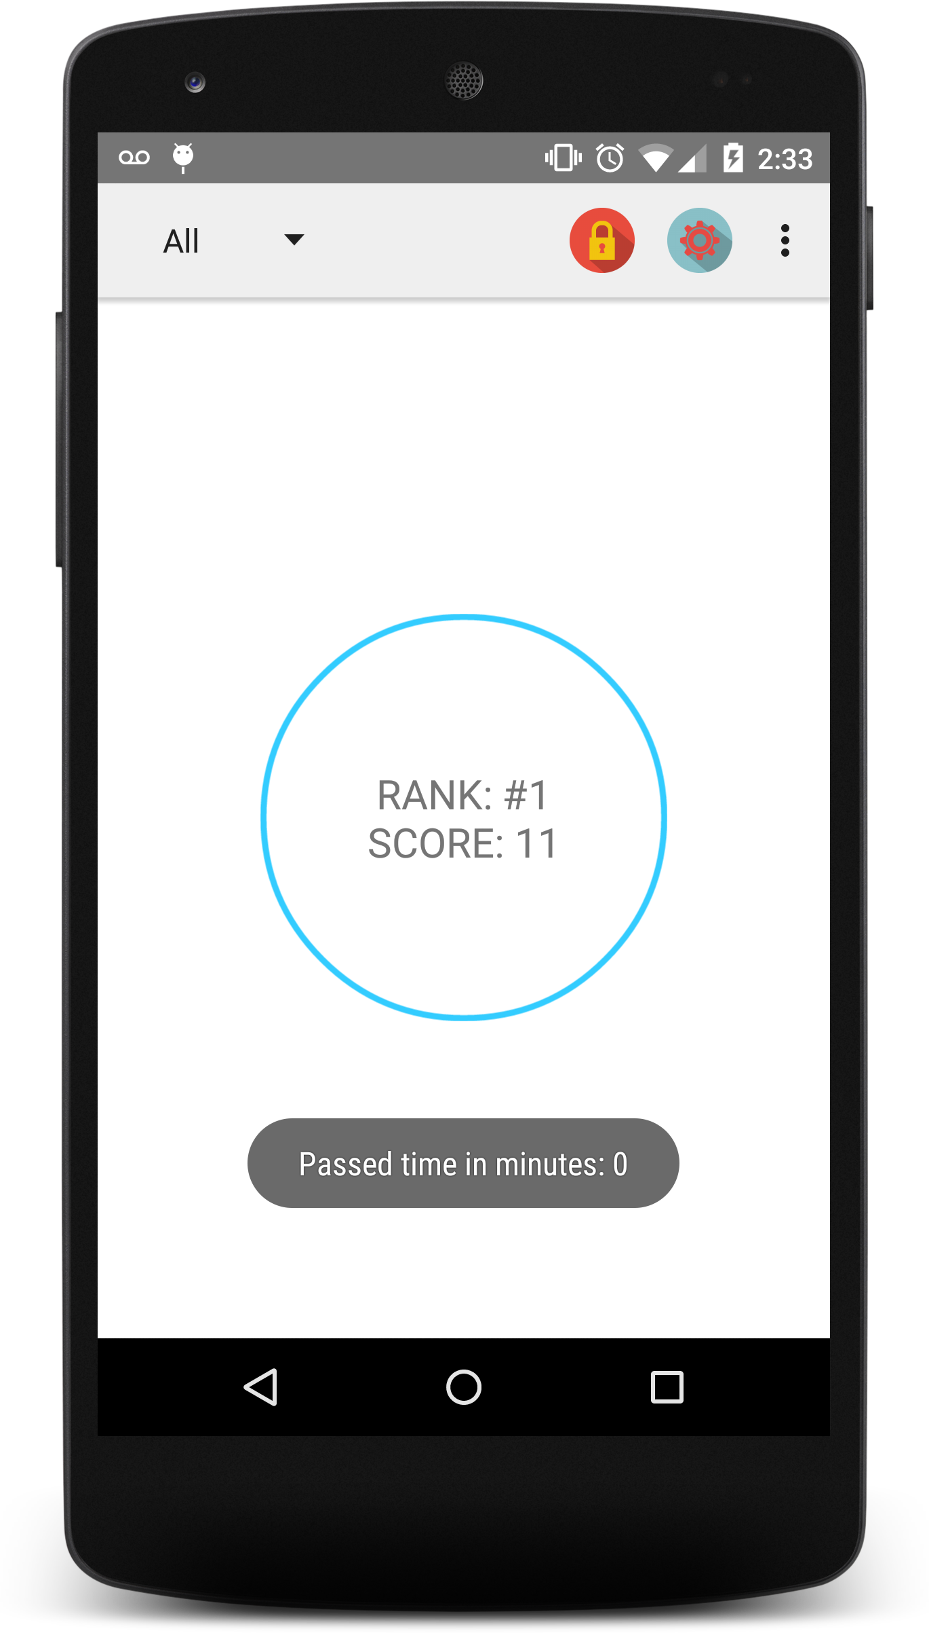
What was done?
Previous Iterations:
Implemented basic Android app to block social apps;
Last Iteration:
Extended Android app;
Developed backend using WA for our Android app;

Slide 4
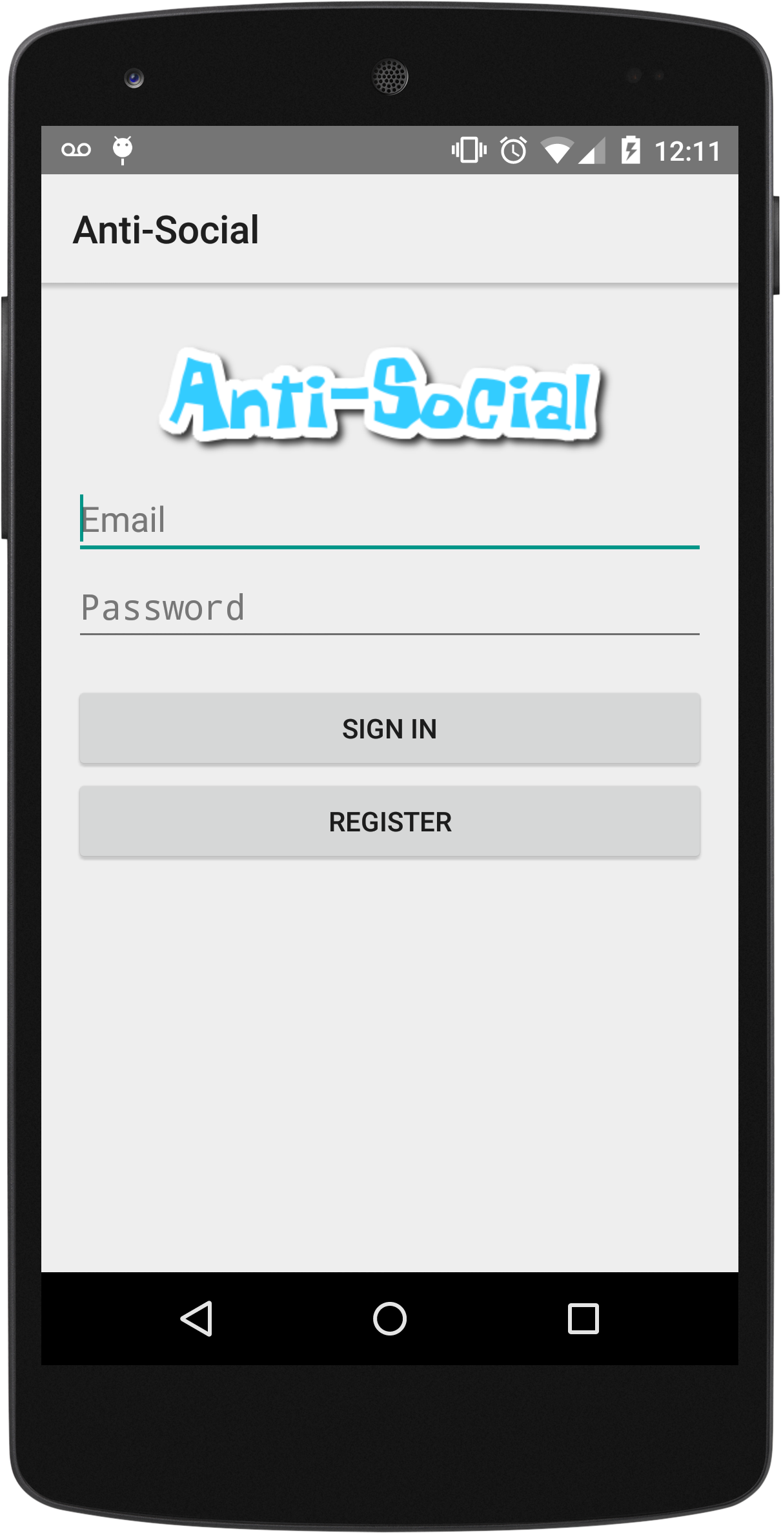
What was done? (cont)
Android app:
External Login/Register;
Integrated timer;
Sending message notification;
Backend:
Login/Register;
API calls for saving the user data;
Groups create, edit, delete;

Slide 5



Overall Architecture
REST Calls
Android App
(Java)
LINQ
LINQ
Database
Antisocial API
(ASP.NET WEB API 2)
Antisocial Web
(ASP.NET MVC 5)

Slide 6



What we learned?
IMPORTANT!
Working as a Team!
Project development strategies;
ADDONS:
Android development (1 week) ;)
A lot of tools (Github, Trello, VS)
Patterns (Adapter, MVC)

Slide 7
Metric
Total Developer Hours/Week: 47
Avg Developer Hours/Week: 11.75
Total Testers Hours/Week: 14
Avg Testers Hours/Week: 7
Defects Detected: 10
Defects Resolved: 3
Passed Unit Tests: 6
Failed Unit Tests: 2

Slide 8
DEMO ;)

Slide 9
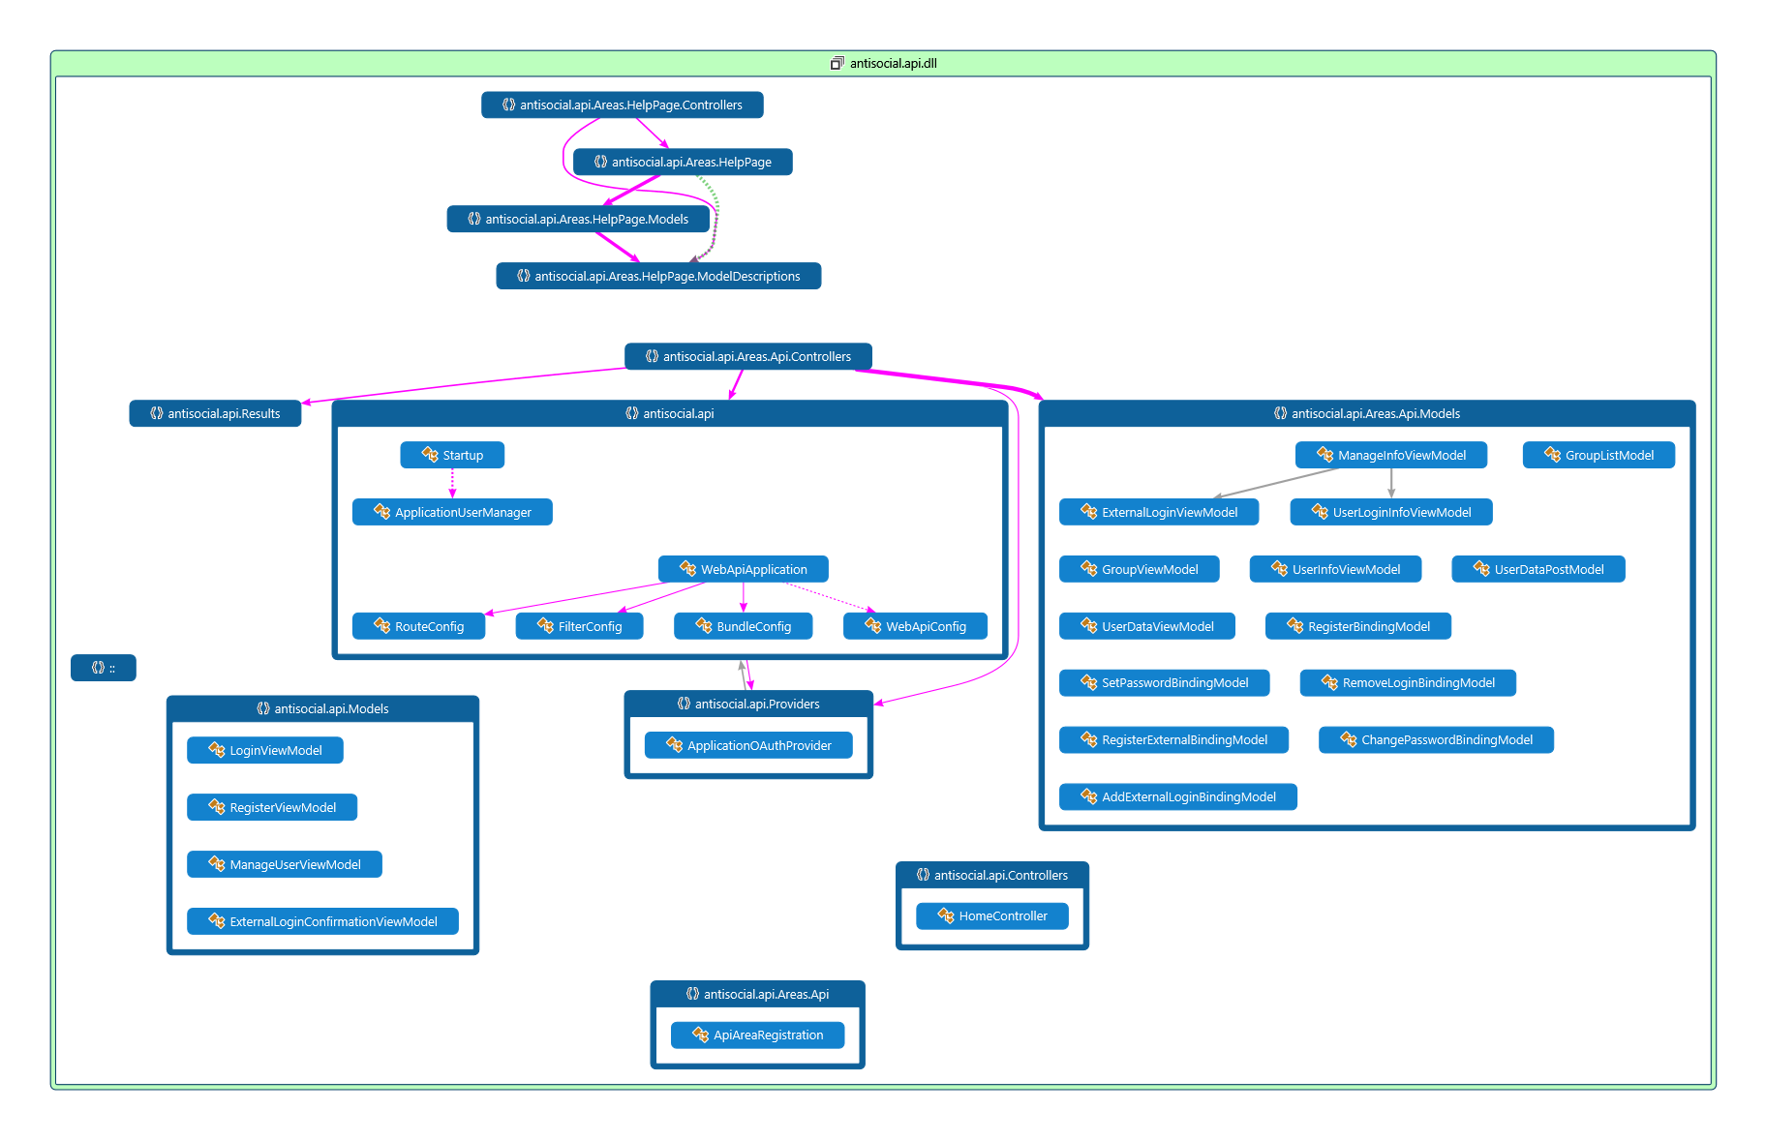
Antisocial API Architecture

Slide 10
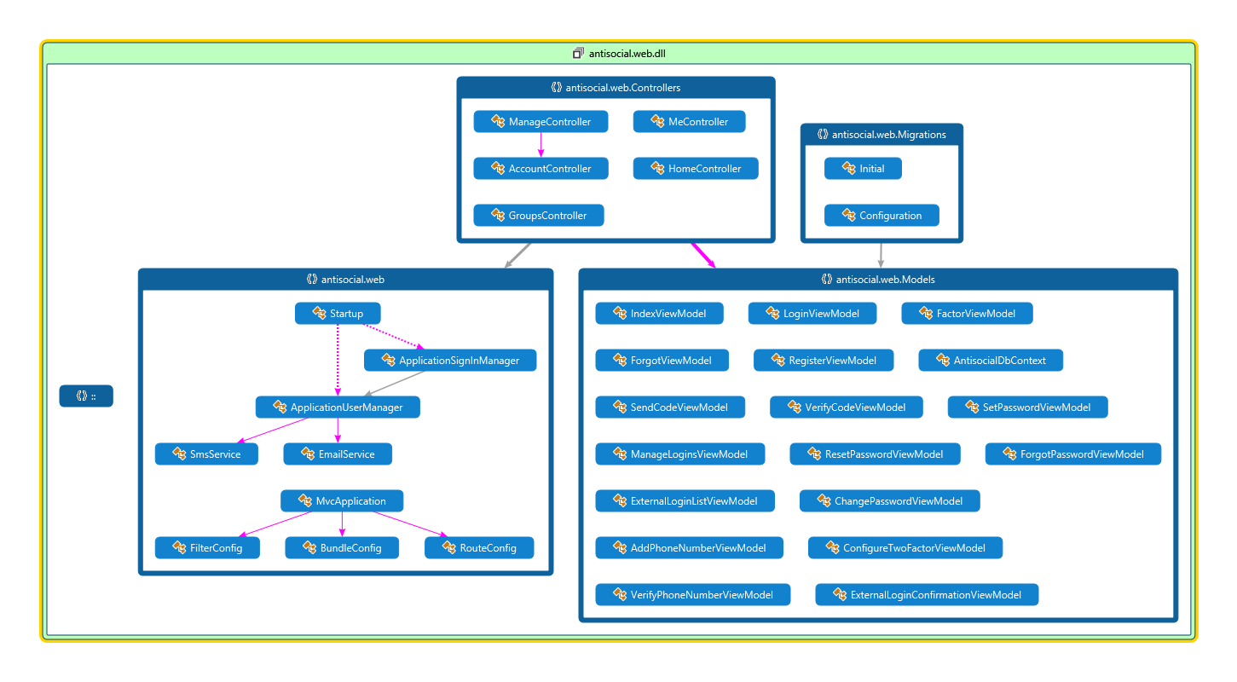
Antisocial Web Architecture

Slide 11
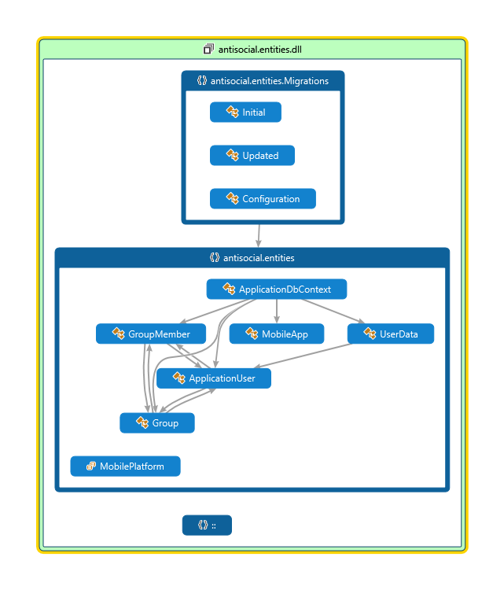
Antisocial Entities Architecture

Slide 12
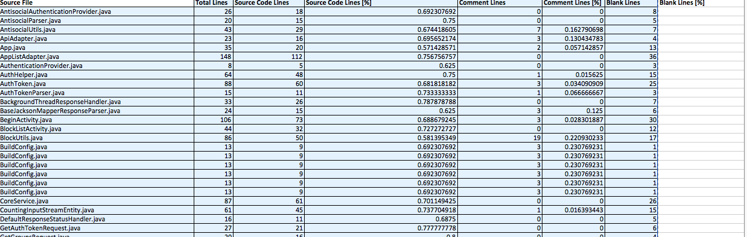
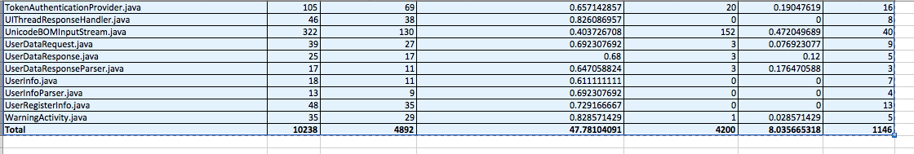
Metrics – Lines of Code

Slide 13
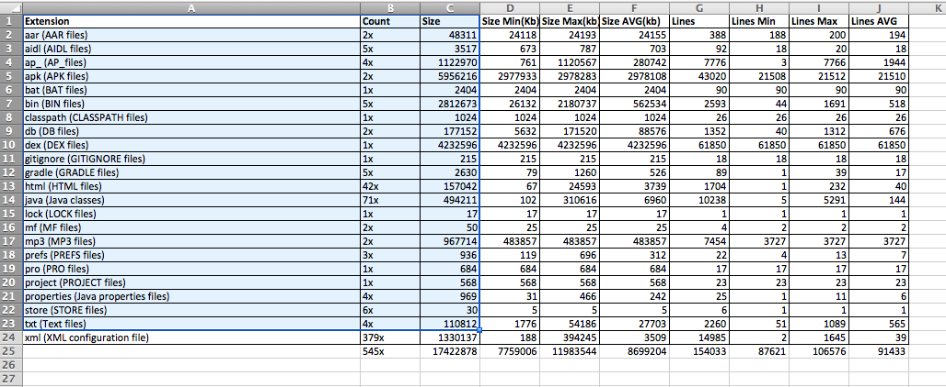
Metrics – Lines of Code 2

Slide 14
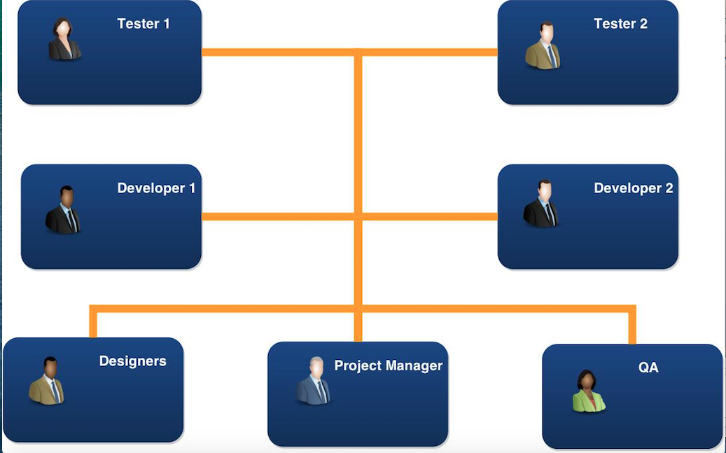
Defects Measurements/Communication

Slide 15
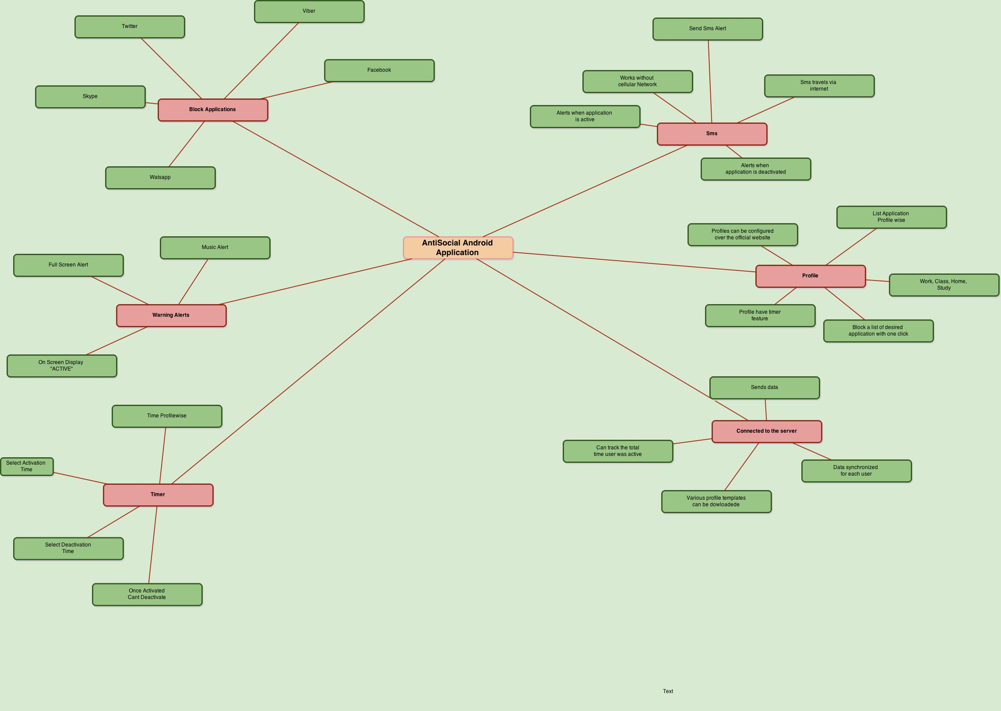
Features

Slide 16
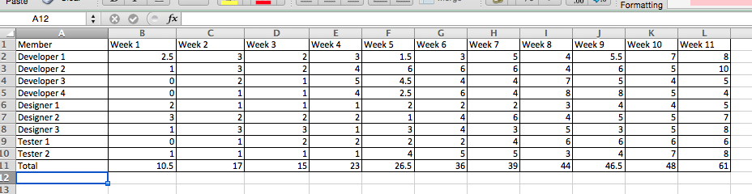
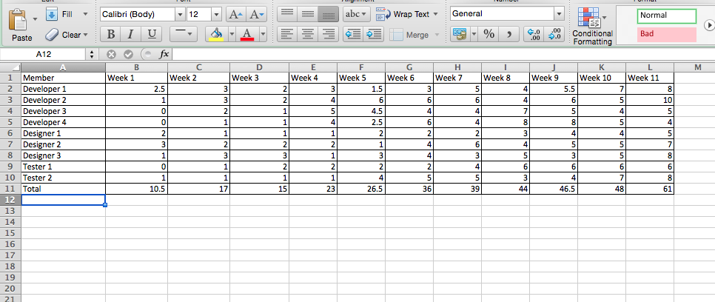
Weekly Summary

Slide 17
Future
The master can see the active slaves on his computer screen
Rehabilitation Mode – User can decrease the usage of social networking applications by selecting the option 4 8 or 12 days. Each day the applications will be blocked compare more number of hours compared to the previous day
Implement the NFC tag
Post directly to twitter and Facebook that total how many hours you were blocking the application. That is end of week or month
Tie up with food chains to provide with coupons for people consistently no using social network apps

Slide 18
Thanks!
Questions?

